Slide 1
Training Neural Networks
By: Romerico David and Alazar Tekeba
Faculty Mentor: Dr. Weixian Liao

Slide 2
What is our project about?
Objective: Mathematical understanding of artificial neural networks, how to tune the parameters to improve the performance of each neural network.
Method: Train 3 types of Neural Networks:
Feed-Forward Neural Networks
Convolution Neural Networks
Recurrent Neural Networks
Notes:
Objective: Focus on the mathematical understanding of neural network architectures and determine how to best tune the parameters within the experiments to improve the performance of each neural network.

Slide 3
Background
1943
Warren McCulloch proposed how neurons may work by creating a simple neural network using electrical circuits.
1950s:
Advancement within computers enabled simulation of neural networks.
1960s:
Frank Rosenblatt introduces the first practical implementation of neural networks that used supervised learning algorithms.
1980s:
David Rumelhart, Geoffrey Hinton, and Ronald Williams maximized the efficiency of the backpropagation learning algorithm.
1980s to present:
Continuous expansion and evolution of the field of neural networks
2012:
AlexNet, a convolutional neural network architecture wins the ILSVRC competition for the first time.
Notes:
1943: Neurophysiologists Warren McCulloch
1960: Perceptrons
2012: The ILSVRC is a major competition that evaluates algorithms in object detection and image classification and is notable for promoting significant break throughs in deep learning and computer vision.

Slide 4
Applications
Convolutional Neural Networks (CNNs):
Image classification
Object detection and recognition
Facial recognition
Video analysis
Recurrent Neural Networks (RNNs):
Prediction problems
Language modeling
Text generation
Speech recognition and translation
Forecasting
Forward-Feed Neural Networks (FNNs):
Fraud detection
Medical diagnosis
Handwriting recognition

Slide 5
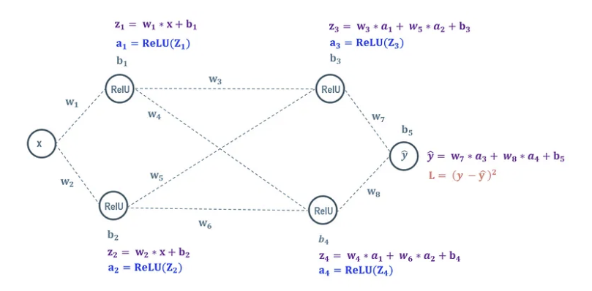
FNN Model & Architecture
Roy, R. (2022, November 17). Neural Networks: Forward pass and Backpropagation. Medium. https://towardsdatascience.com/neural-networks-forward-pass-and-backpropagation-be3b75a1cfcc
Notes:
Forward Feed Process:
Each node takes an input and is combined with its corresponding weight(s) and bias that determine the input for the next layer. These parameters are initialized to random values.
Weights can be excitatory (positive) or inhibitory (negative), increasing or decreasing the activation of a node respectively.
Activation functions (e.g., Sigmoid, ReLU, hyperbolic tangent) that embed the data between some range.
Backpropagation Process:
The model adjusts the weights and biases to minimize the overall loss function, the Mean Squared Error.
Gradient Descent Strategy: The gradient is the direction of steepest ascent where the function is maximized as quickly as possible. The negative of the gradient performs the opposite operation, minimizing the function as quickly as possible. This value represent the direction of change needed to minimize the loss and the weights and biases are scaled based on a predetermined learning rate.
The model iteratively propagates a data set backward through the network, calculating the gradients of each weight and bias.
Model: Utilized a digits dataset to accurately classify an input to its actual number.
Hyperparameters:
Learning Rate
Size of hidden layer
Number of iterations

Slide 6
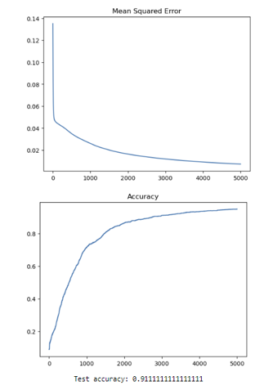
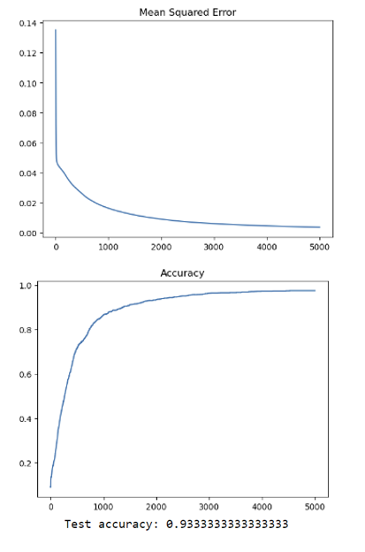
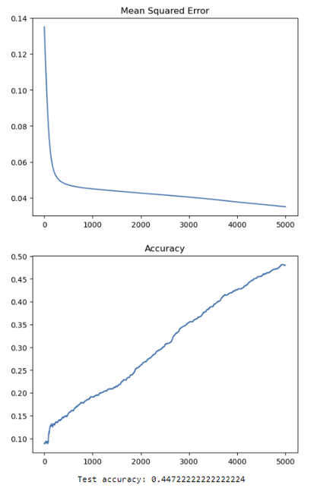
Findings for FNN Model
Learning Rate: 0.1
Iterations: 5000
Learning Rate: 0.2
Iterations: 5000
Learning Rate: 0.01
Iterations: 5000
Notes:
Greater number of iterations means greater accuracy, no drawbacks.
Greater number of hidden layer nodes and learning rate increase the accuracy but also increases the chance of the model overfitting.
Overfitting: The model is overly trained it inaccurately classifies a new dataset/the testing data. The model is overfit when the training data accuracy is high and the testing data accuracy is low.

Slide 7
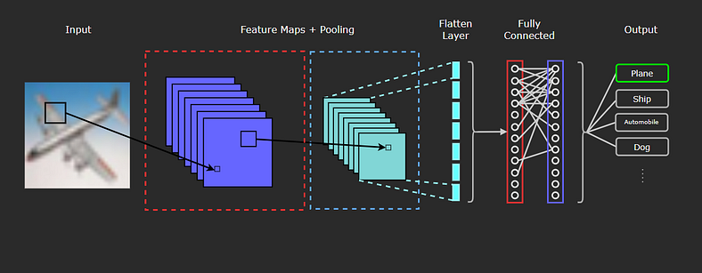
CNN Model & Architecture
Kamali, K. (2023, January 24). Deep Learning (Part 3) - Convolutional neural networks (CNN) [Text]. Galaxy Training Network. https://training.galaxyproject.org/training-material/topics/statistics/tutorials/CNN/tutorial.html
Notes:
Convolutional Layer:
Layers that extracts specific features from the input data.
Kernels (filters): A matrix of weights that scans over the input. Performs the matrix multiplication at each stop and outputs the value into a new array called a feature map. Weights learn through backpropagation.
Activation Function:
ReLU activation function is applied to make all values non-negative. Prevents the data from becoming unmanageably large. Applied after the convolution layer and before the pooling layer.
Pooling Layer:
Performs down sampling to reduce the spatial dimensionality of the data. Decreases the number of parameters thus reducing learning time and computation and the likelihood of overfitting.
Flattening Layer:
Flattening operation is done after all the convolution layers to convert the data to 1d input vectors. These input vectors are maximized by taking their receptive fields. These receptive fields are important in forming patterns and informing classifications of the original image in the Fully Connected Layer.
Fully Connected Layer:
Responsible for the classification of the image. Same processes to ANN Architecture.
Model:
Utilized CIFAR10 dataset that has 10 classes of images. Use four conv2d layers, flattening layer, batch normalization, dropout (as pooling layer), Cross-Entropy Loss Function, and Adam optimizer learning algorithm.
Hyperparameters:
Tolerance Level
Batch size, Epochs
Number of kernels, number of layers in FC layer
Optimization techniques: Grid search, image augmentation, early stopping

Slide 8
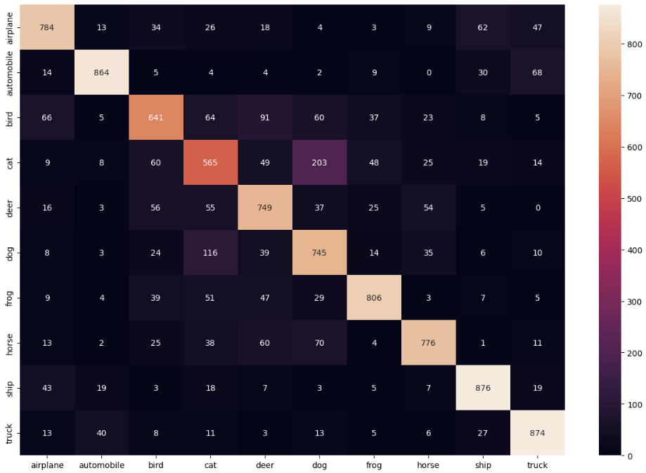
Findings for CNN Model
 | Accuracy
Airplane | 0.882
Automobile | 0.828
Bird | 0.548
Cat | 0.458
Deer | 0.654
Dog | 0.750
Frog | 0.579
Horse | 0.889
Ship | 0.733
Truck | 0.833
Avg Accuracy & Loss: | 76.3% and 0.69 loss
Confusion Matrix

Slide 9
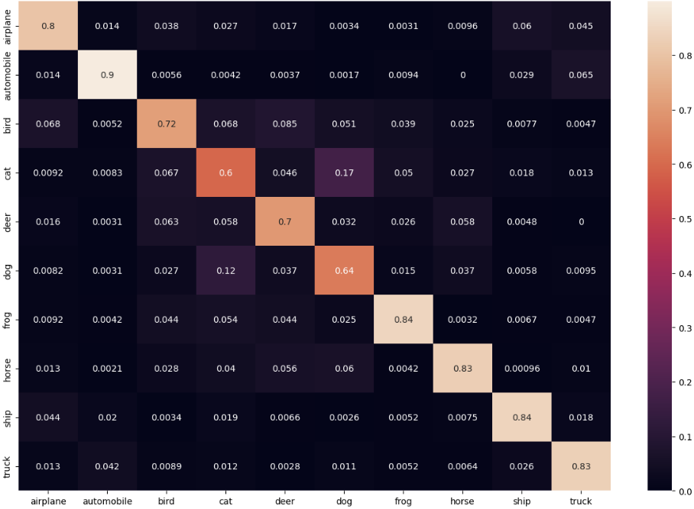

Findings for CNN Model
Precision: The fraction of identified positive cases correctly predicted
Recall: The fraction of actual positive cases that are correctly predicted

Slide 10
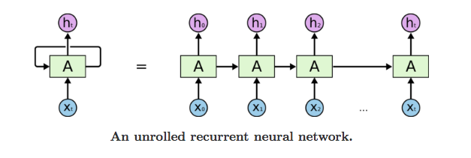
RNN Architecture
Notes:
Basic building block in sequential data processing and natural language tasks
One-directional flow of information from input to output, with feedback loop
HIDDEN LAYER
Unlike traditional neural networks the outputs in the network are dependent on the previously generated one.
This way, it keeps remembering the context while training.
Key component: Hidden state, acting as memory to store past information
For example, when predicting the next word in a sentence, the hidden state will be helpful in remembering the previous word to use context to accurately guess the next one.
Once all the time steps are completed, the output is then compared to the actual output and the error is generated. The error is then back-propagated to the network to update the weights and hence the network (RNN) is trained.

Slide 11
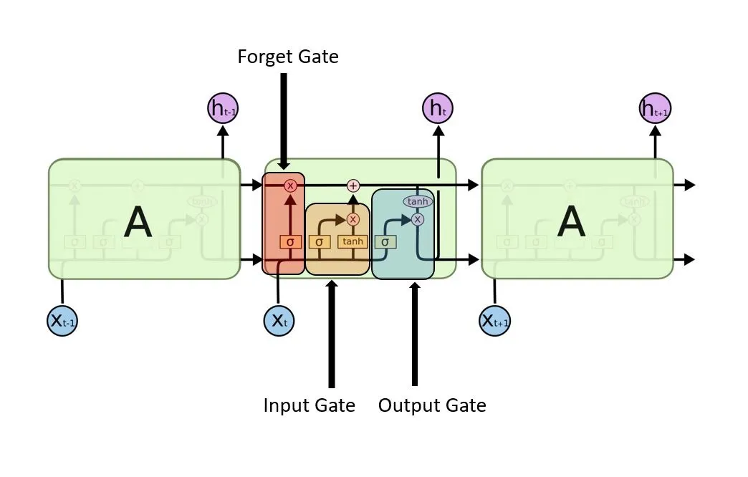
LSTM (Long Short Term Memory)
Notes:
Vanishing gradient
It trains the model by using back-propagation. In an LSTM network, three gates are present
Input gate — discover which value from input should be used to modify the memory.
Forget gate — discover what details to be discarded from the block. It is decided by the sigmoid function.
Output gate — the input and the memory of the block is used to decide the output.

Slide 12
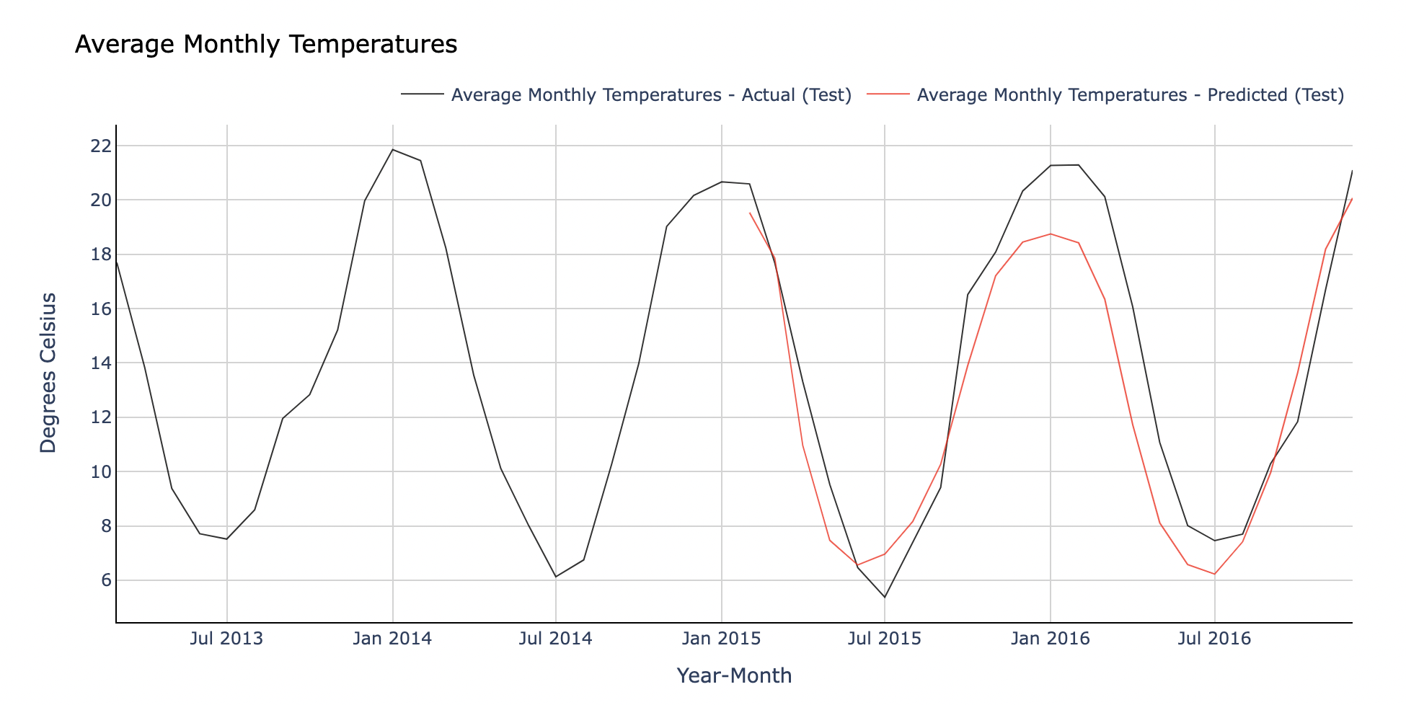
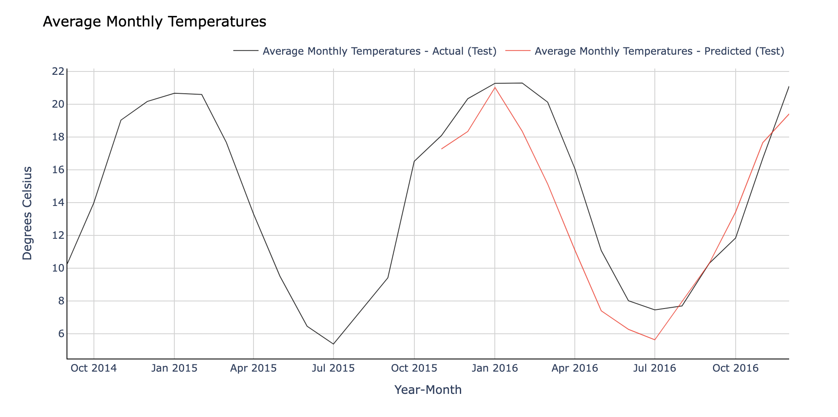
Findings for RNN Model
Canberra
22 timestep + 1000 epoch
18 timestep + 2000 epoch​

Slide 13
Future Work
Continue evaluating the mathematical concepts of our neural networks and determining how to best tune the hyperparameters of our model

Slide 14

Thank you!

Slide 15
References
A. K. Jain, Jianchang Mao and K. M. Mohiuddin, "Artificial neural networks: a tutorial," in Computer, vol. 29, no. 3, pp. 31-44, March 1996, doi: 10.1109/2.485891.
Introduction to Artificial Neutral Networks | Set 1. (2018, January 21). GeeksforGeeks. https://www.geeksforgeeks.org/introduction-to-artificial-neutral-networks/
Roy, R. (2022, November 17). Neural Networks: Forward pass and Backpropagation. Medium. https://towardsdatascience.com/neural-networks-forward-pass-and-backpropagation-be3b75a1cfcc
Han, J., Kamber, M., & Pei, J. (2012). Data mining: Concepts and techniques, third edition (3rd ed.). Morgan Kaufmann Publishers.
What is Gradient Descent? | IBM. (n.d.). Retrieved June 30, 2023, from https://www.ibm.com/topics/gradient-descent
Kamali, K. (2023, January 24). Deep Learning (Part 3) - Convolutional neural networks (CNN) [Text]. Galaxy Training Network. https://training.galaxyproject.org/training-material/topics/statistics/tutorials/CNN/tutorial.html
Brandon Rohrer. (2018, October 17). How convolutional neural networks work, in depth. https://www.youtube.com/watch?v=JB8T_zN7ZC0
Flores, T. (2023, February 14). Intro to PyTorch 2: Convolutional Neural Networks. Medium. https://towardsdatascience.com/intro-to-pytorch-2-convolutional-neural-networks-487d8a35139a
Narkhede, S. (2021, June 15). Understanding Confusion Matrix. Medium. https://towardsdatascience.com/understanding-confusion-matrix-a9ad42dcfd62
Classification: Precision and Recall | Machine Learning. (n.d.). Google for Developers. Retrieved July 12, 2023, from https://developers.google.com/machine-learning/crash-course/classification/precision-and-recall
Mittal, A. (2019, October 12). Understanding RNN and LSTM. Medium. https://aditi-mittal.medium.com/understanding-rnn-and-lstm-f7cdf6dfc14e

